Slide 1
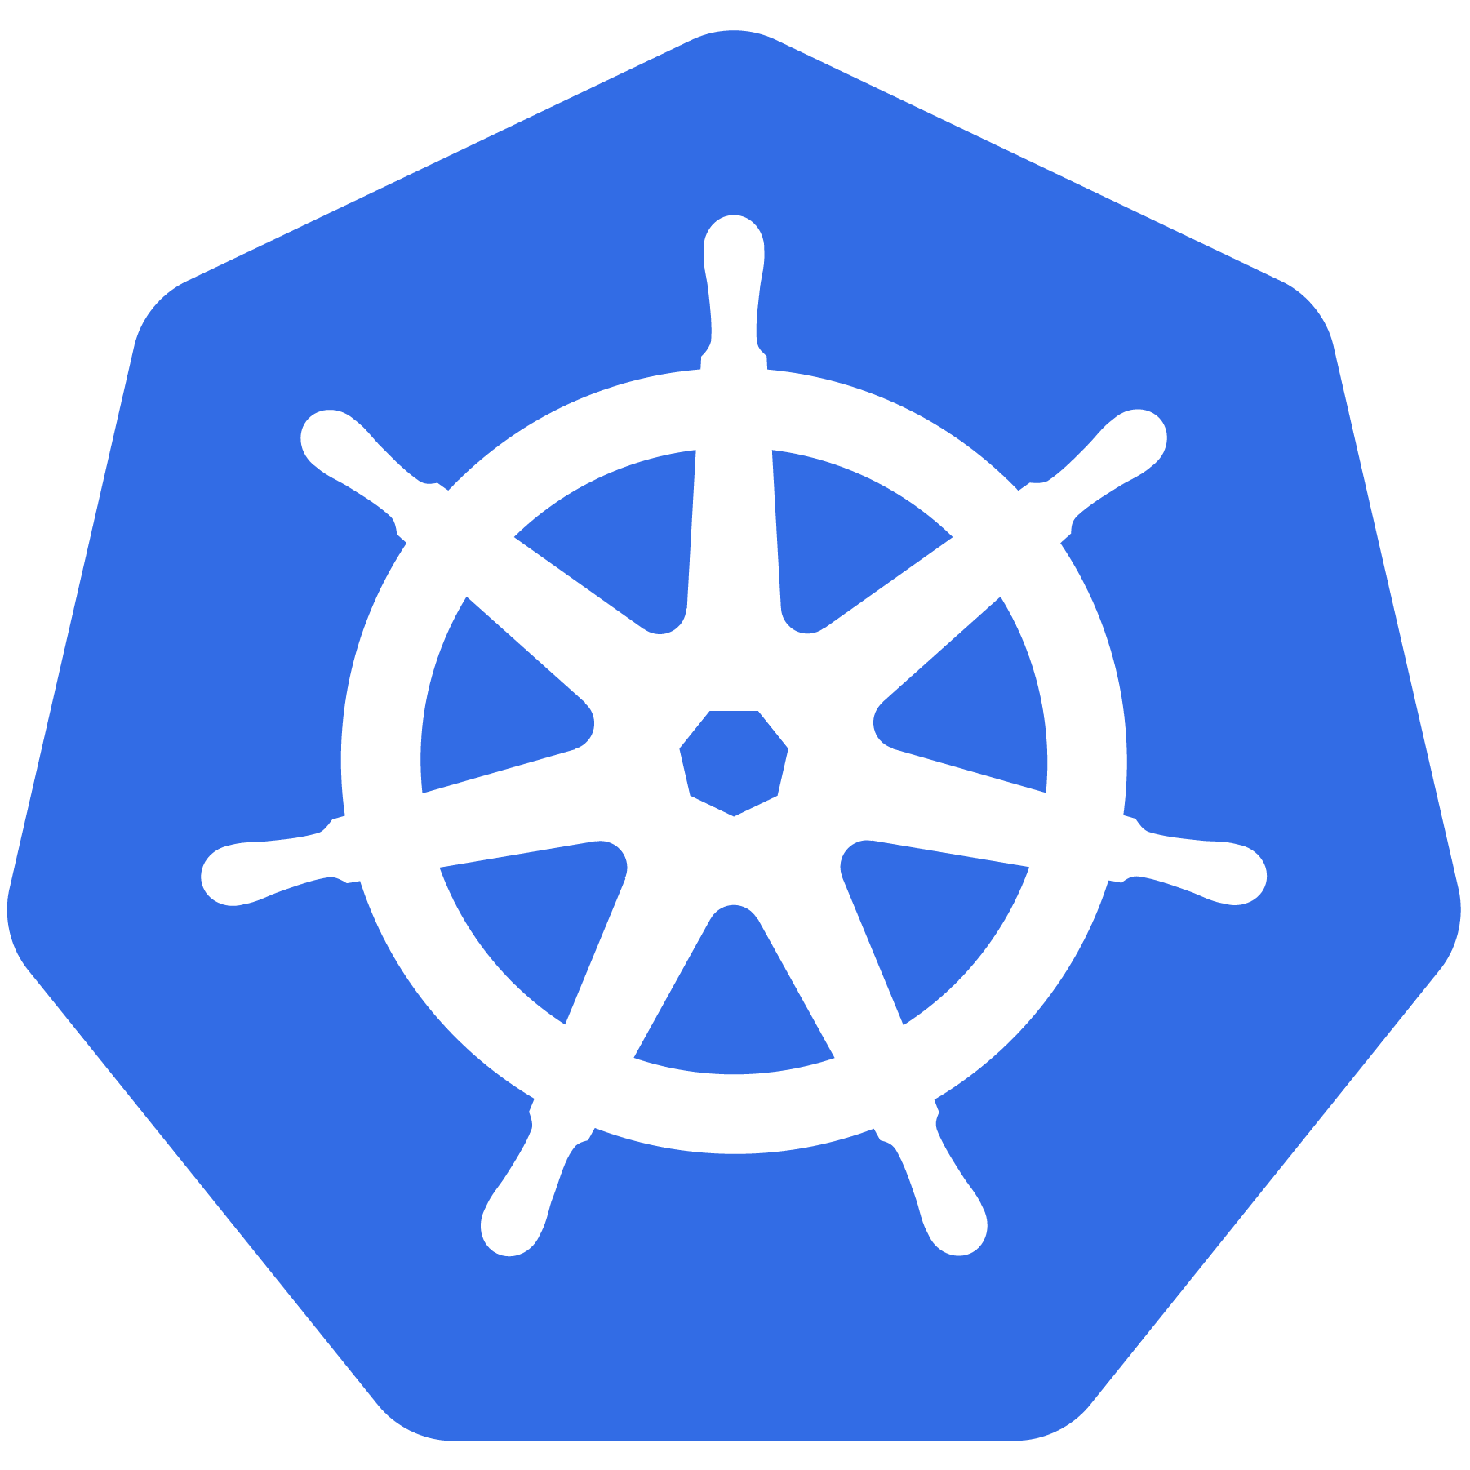
Kubernetes
An Introduction

Slide 2



$ whoami - Dishant
Dishant Makwana
dishantm70@gmail.com
Senior Associate Infrastructure
https://field360.in

Slide 3
https://rb.gy/k0ias

Slide 4
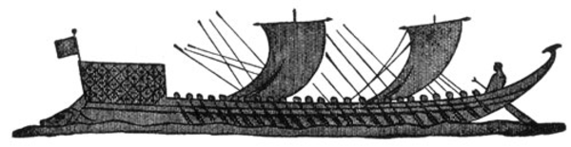
What Does “Kubernetes” Mean?
Greek for “pilot” or
“Helmsman of a ship”
Image Source
Notes:
The first question always asked
There is also the abbreviation of K8s -- K, eight letters, s

Slide 5
What is Kubernetes?
Project that was spun out of Google as an open source container orchestration platform.
Built from the lessons learned in the experiences of developing and running Google’s Borg and Omega.
Designed from the ground-up as a loosely coupled collection of components centered around deploying, maintaining and scaling workloads.
Notes:
There’s a phrase called Google-scale. This was developed out of a need to scale large container applications across Google-scale infrastructure
borg is the man behind the curtain managing everything in google
Kubernetes is loosely coupled, meaning that all the components have little knowledge of each other and function independently.
This makes them easy to replace and integrate with a wide variety of systems

Slide 6

Who “Manages” Kubernetes?
The CNCF is a child entity of the Linux Foundation and operates as a vendor neutral governance group.
Notes:
CNCF is a sub-foundation of the Linux Foundation
A vendor neutral entity to manage “cloud native” projects
Projects that are “cloud native” generally focus on:
containers
dynamic orchestration
enable “microservice” deployment methodologies
can be logging, monitoring, containerizers etc
Kubernetes was the first project under the CNCF, and the first to be “graduated”

Slide 7
What Does Kubernetes do?
Known as the linux kernel of distributed systems.
Abstracts away the underlying hardware of the nodes and provides a uniform interface for workloads to be both deployed and consume the shared pool of resources.
Works as an engine for resolving state by converging actual and the desired state of the system.
Notes:
linux kernel of distributed systems
Sort of like a hypervisors, in that it abstracts away the underlying host resources and shares them in a normalized way.
the underlying substrate or platform to build your applications and tools on top of
Think of Kubernetes like a higher-level language for your application architecture.
you describe what you need and it tries to resolve it
with that in mind, it acts as an engine to resolve state using the abstracted resources to deploy and manage your application.
It is declarative, and not imperative. You tell it or “declare” what you want, and it figures out the rest.
imperative you tell something every step you want it to do
declarative you tell it what you want it to be, and it figures it out
e.g. ‘I want 5 instances of x’ and it just does it, if something dies, it brings it back to get to 5

Slide 8
Decouples Infrastructure and Scaling
All services within Kubernetes are natively Load Balanced.
Can scale up and down dynamically.
Used both to enable self-healing and seamless upgrading or rollback of applications.
Notes:
A lot of key components are batteries-included

Slide 9

Most Importantly...
Use the SAME API across bare metal and EVERY cloud provider!!!
Notes:
Single biggest value-add Kubernetes can offer

Slide 10
Self Healing
Kubernetes will ALWAYS try and steer the cluster to its desired state.
Me: “I want 3 healthy instances of redis to always be running.”
Kubernetes: “Okay, I’ll ensure there are always 3 instances up and running.”
Kubernetes: “Oh look, one has died. I’m going to attempt to spin up a new one.”
Notes:
The instance will have a new IP and likely be on a different host, but Kubernetes gives the primitives for us to ‘not care’ about that.

Slide 11
What can Kubernetes REALLY do?
Autoscale Workloads
Blue/Green Deployments
Fire off jobs and scheduled cronjobs
Manage Stateless and Stateful Applications
Provide native methods of service discovery
Easily integrate and support 3rd party apps
Notes:
Everything here requires some level of configuration

Slide 12

API Overview
The REST API is the true keystone of Kubernetes.
Everything within the Kubernetes is as an API Object.
Image Source
Notes:
API-Server is the keystone to Kubernetes
Every component communicates with it
Everything created within Kubernetes is an API object or resource
This is object-oriented application architecture

Slide 13
API Groups
Designed to make it extremely simple to both understand and extend.
An API Group is a REST compatible path that acts as the type descriptor for a Kubernetes object.
Referenced within an object as the apiVersion and kind.
Format:
/apis/<group>/<version>/<resource>
Examples:
/apis/apps/v1/deployments
/apis/batch/v1beta1/cronjobs
Notes:
Every object in kubernetes belongs to an API Group
The API Group is a REST compatible path that acts as the type descriptor for a Kubernetes object.
apiVersion is the version of the object we’re creating
kind is the specific type of object or resource being created

Slide 14
Object Model
Objects are a “record of intent” or a persistent entity that represent the desired state of the object within the cluster.
All objects MUST have apiVersion, kind, and poses the nested fields metadata.name, metadata.namespace, and metadata.uid.
Notes:
Record of intent may sound odd, but here’s another way of looking at it.
If you order pizza for delivery, you have specified clearly what you want delivered.
This establishes the type of object, the version of the object and a unique identity for the object itself
HOWEVER when defining an object, many fields are optional (namespace can be inherited. UID can be generated)

Slide 15
Object Model Requirements
apiVersion: Kubernetes API version of the Object
kind: Type of Kubernetes Object
metadata.name: Unique name of the Object
metadata.namespace: Scoped environment name that the object belongs to (will default to current).
metadata.uid: The (generated) uid for an object.
apiVersion: v1
kind: Pod
metadata:
name: pod-example namespace: default
uid: f8798d82-1185-11e8-94ce-080027b3c7a6

Slide 16
Object Expression - YAML
Files or other representations of Kubernetes Objects are generally represented in YAML.
A “Human Friendly” data serialization standard.
Uses white space (specifically spaces) alignment to denote ownership.
Three basic data types:
mappings - hash or dictionary,
sequences - array or list
scalars - string, number, boolean etc
Notes:
YAML Ain't Markup Language
“Human friendly”....till things get complicated

Slide 17
Object Expression - YAML
apiVersion: v1
kind: Pod
metadata:
name: yaml
spec:
containers:
- name: container1
image: nginx
- name: container2
image: alpine
Notes:
Super simple example

Slide 18
YAML vs JSON
apiVersion: v1
kind: Pod
metadata:
name: pod-example
spec:
containers:
- name: nginx
image: nginx:stable-alpine
ports:
- containerPort: 80
{
"apiVersion": "v1",
"kind": "Pod",
"metadata": {
"name": "pod-example"
},
"spec": {
"containers": [
{
"name": "nginx",
"image": "nginx:stable-alpine",
"ports": [ { "containerPort": 80 } ]
}
]
}
}

Slide 19
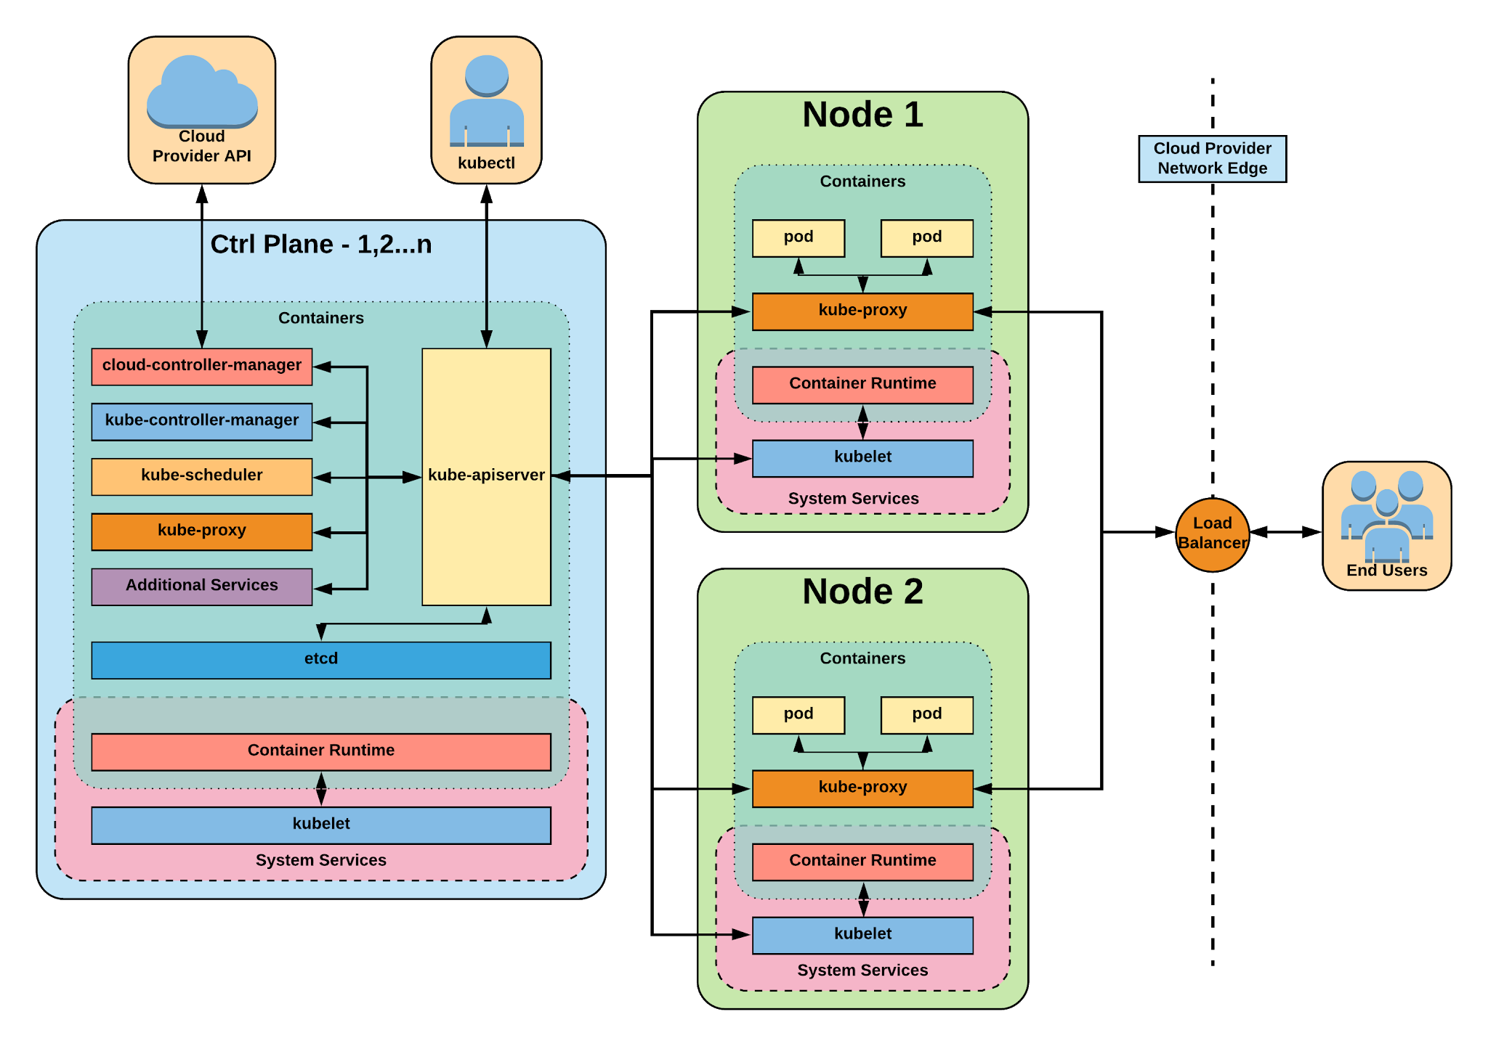
Notes:
The complete picture

Slide 20
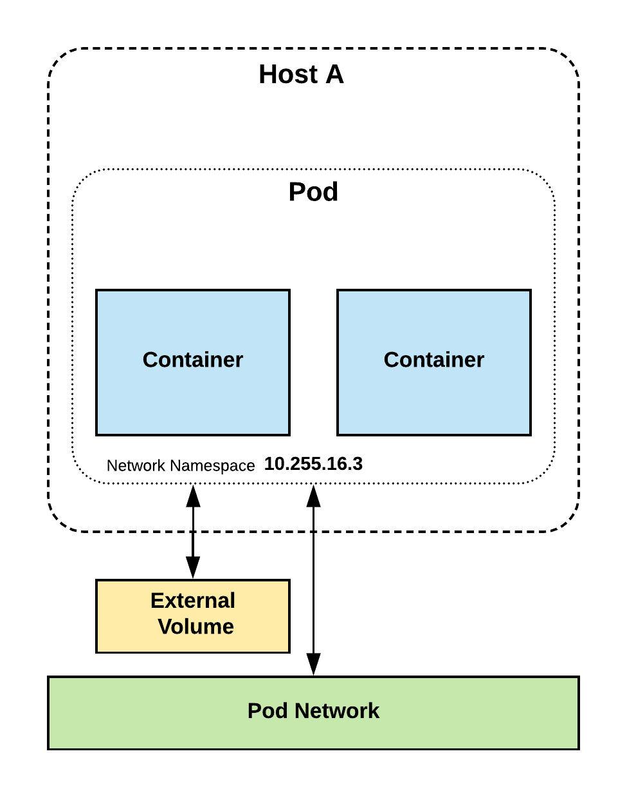
Pod
Atomic unit or smallest “unit of work”of Kubernetes.
Pods are one or MORE containers that share volumes, a network namespace, and are a part of a single context.

Slide 21
Pods
They are
also
Ephemeral!
Notes:
Higher level objects manage replicas, fault tolerance etc.

Slide 22
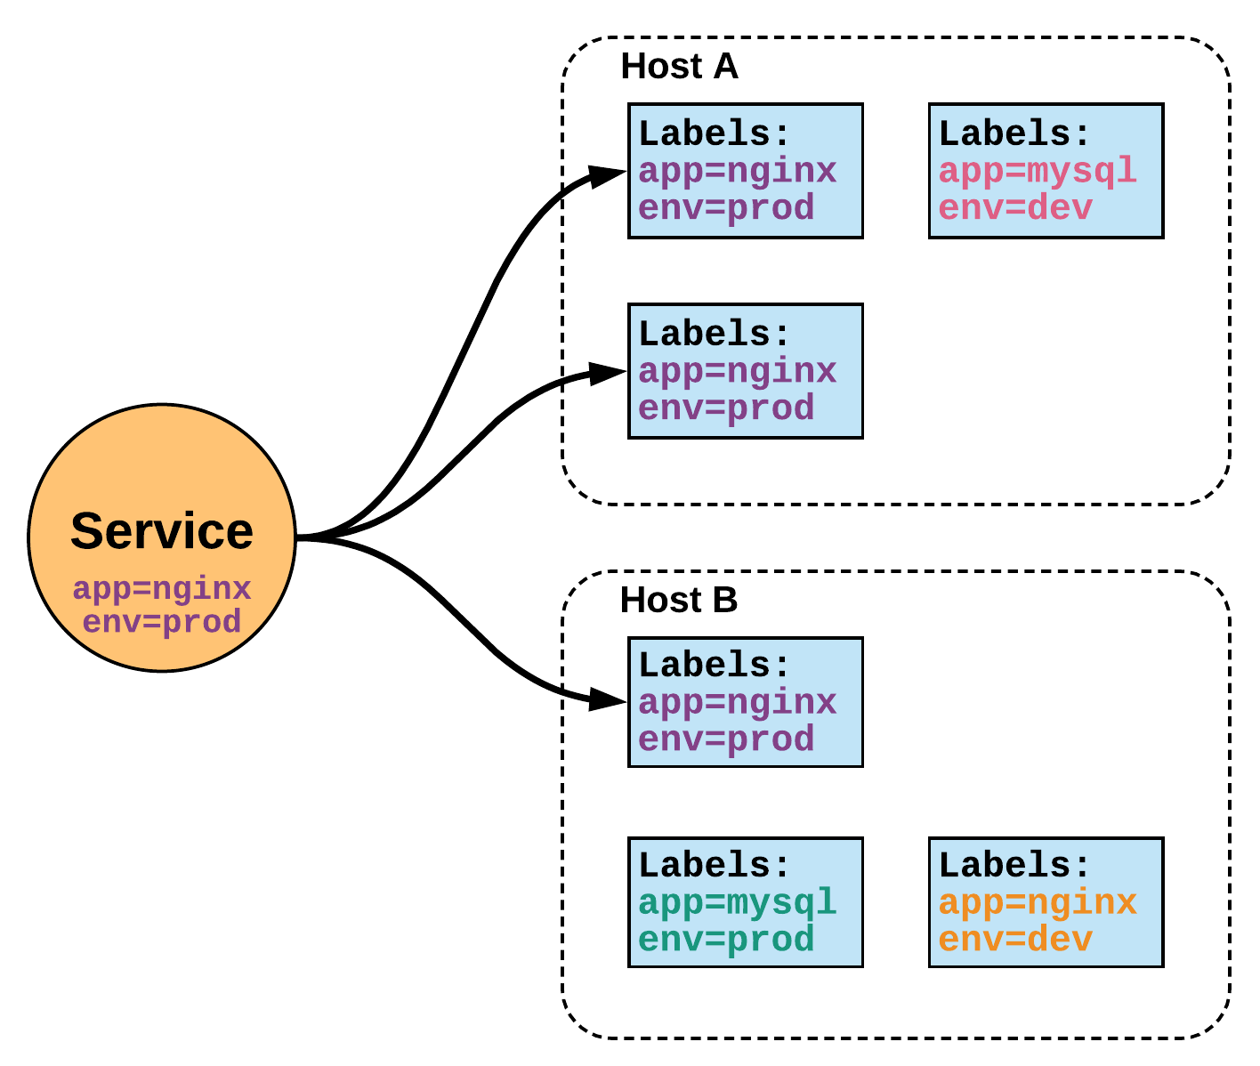
Service
Unified method of accessing the exposed workloads of Pods.
Durable resource
static cluster IP
static namespaced DNS name
Notes:
While this may seem like a technical definition, in practice it can be viewed more simply:
A service is an internal load balancer to your pod(s). You have 3 HTTP pods scheduled? Create a service, reference the pods, and (internally) it will load balance across the three.

Slide 23
Services
Unified method of accessing the exposed workloads of Pods.
Durable resource
static cluster IP
static namespaced DNS name
NOT Ephemeral!
Notes:
Services are persistent objects used to reference ephemeral resources

Slide 24
Service Types
There are 4 major service types:
ClusterIP (default)
NodePort
LoadBalancer
ExternalName
Notes:
clusterIP,LB - Bob
Nodeport,External - Jeff

Slide 25
ClusterIP Service
ClusterIP services exposes a service on a strictly cluster internal virtual IP.
apiVersion: v1
kind: Service
metadata:
name: example-prod
spec:
selector:
app: nginx
env: prod
ports:
- protocol: TCP
port: 80
targetPort: 80
Notes:
ClusterIP is an internal LB for your application

Slide 26
NodePort Service
NodePort services extend the ClusterIP service.
Exposes a port on every node’s IP.
Port can either be statically defined, or dynamically taken from a range between 30000-32767.
apiVersion: v1
kind: Service
metadata:
name: example-prod
spec:
type: NodePort
selector:
app: nginx
env: prod
ports:
- nodePort: 32410
protocol: TCP
port: 80
targetPort: 80
Notes:
NodePort behaves just like ClusterIP, except it also exposes the service on a (random or specified) port on every Node in your cluster.

Slide 27
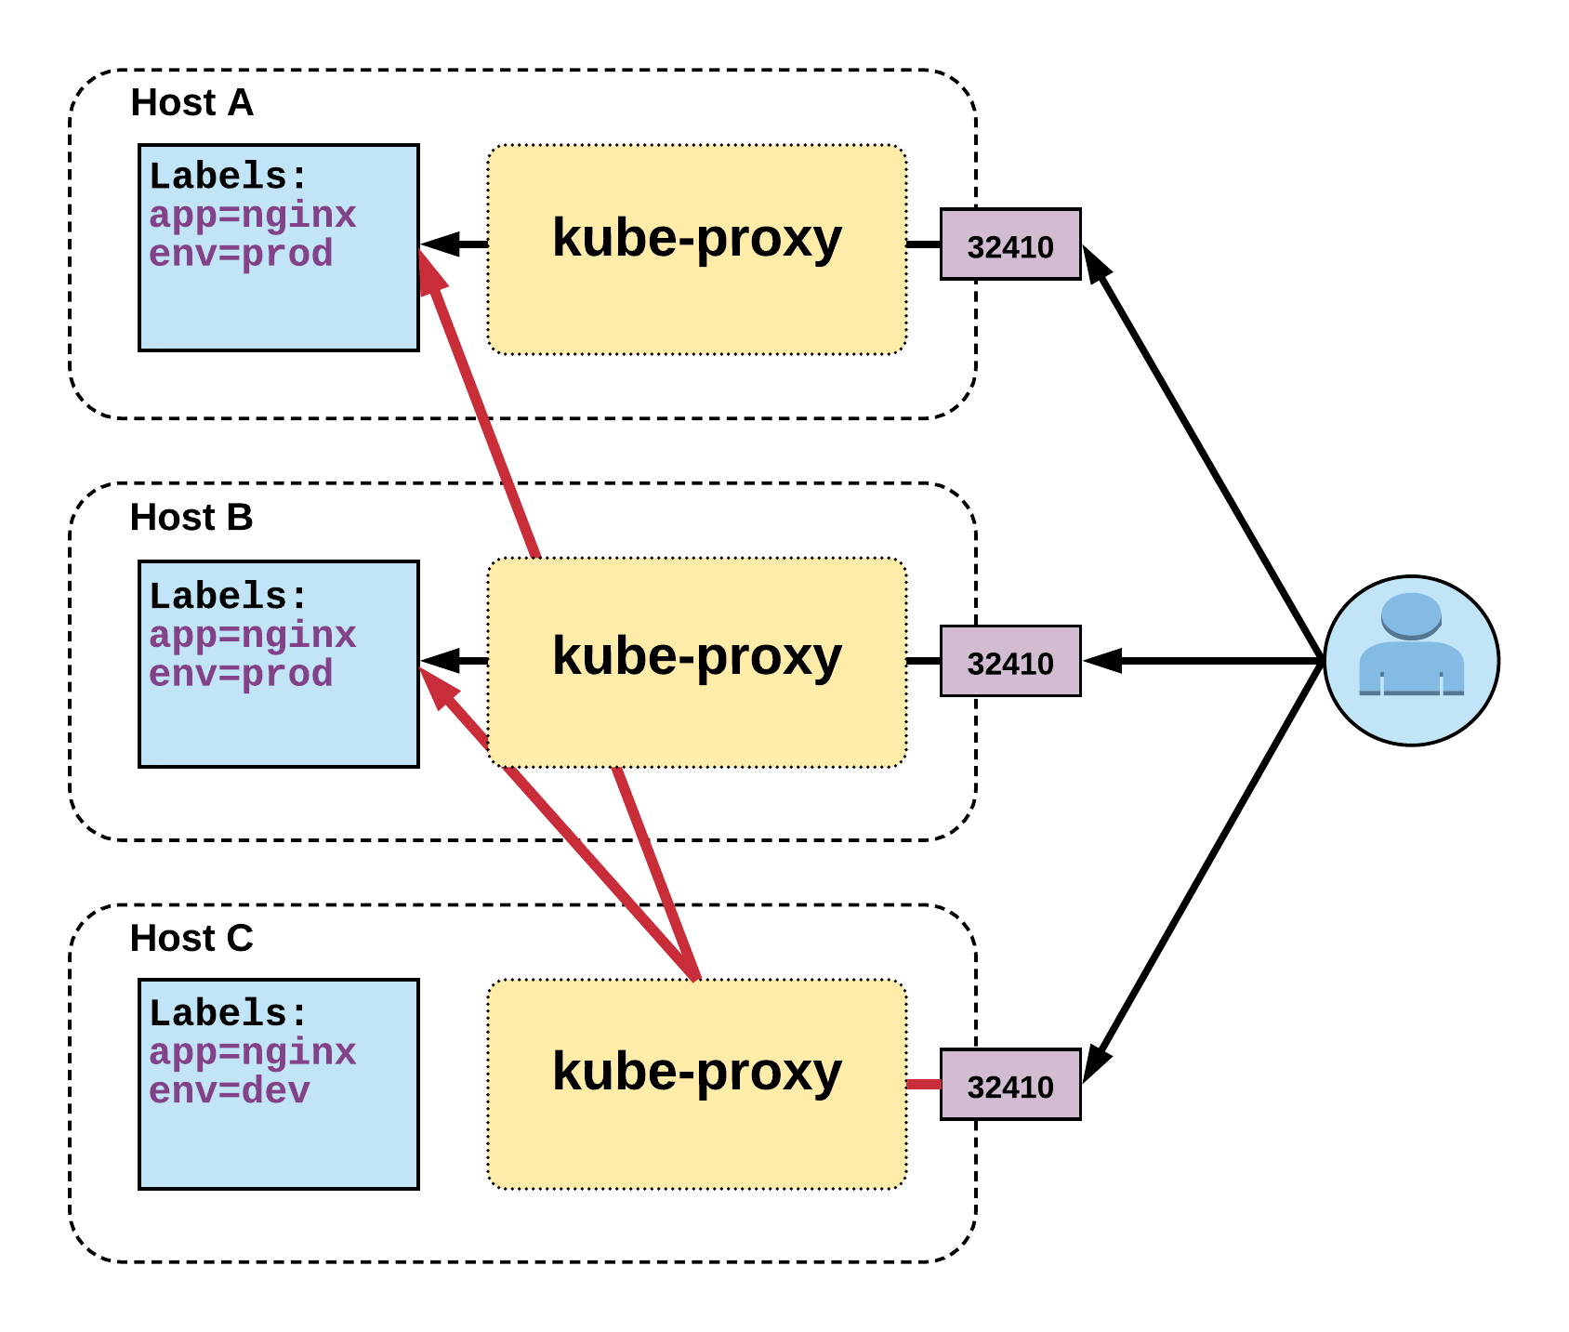
NodePort Service
Name: example-prod
Selector: app=nginx,env=prod
Type: NodePort
IP: 10.96.28.176
Port: <unset> 80/TCP
TargetPort: 80/TCP
NodePort: <unset> 32410/TCP
Endpoints: 10.255.16.3:80, 10.255.16.4:80
Notes:
User can hit any host in cluster on nodeport IP and get to service
Does introduce extra hop if hitting a host without instance of the pod

Slide 28
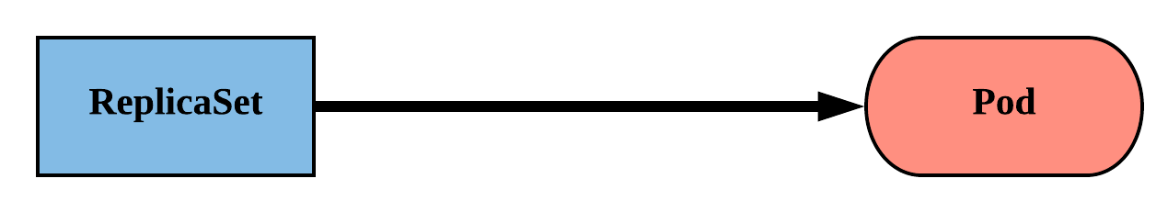
ReplicaSet
Primary method of managing pod replicas and their lifecycle.
Includes their scheduling, scaling, and deletion.
Their job is simple: Always ensure the desired number of pods are running.
Notes:
ReplicaSets are “dumb”
They strive to ensure the number of pods you want running will stay running

Slide 29
ReplicaSet
replicas: The desired number of instances of the Pod.
selector:The label selector for the ReplicaSet will manage ALL Pod instances that it targets; whether it’s desired or not.
apiVersion: apps/v1
kind: ReplicaSet
metadata:
name: rs-example
spec:
replicas: 3
selector:
matchLabels:
app: nginx env: prod
template:
<pod template>
Notes:
You define the number of pods you want running with the replicas field.
You then define the selector the ReplicaSet will use to look for Pods and ensure they’re running.

Slide 30
ReplicaSet
apiVersion: apps/v1
kind: ReplicaSet
metadata:
name: rs-example
spec:
replicas: 3
selector:
matchLabels:
app: nginx env: prod
template:
metadata:
labels:
app: nginx
env: prod
spec:
containers:
- name: nginx
image: nginx:stable-alpine
ports:
- containerPort: 80
$ kubectl get pods
NAME READY STATUS RESTARTS AGE
rs-example-9l4dt 1/1 Running 0 1h
rs-example-b7bcg 1/1 Running 0 1h
rs-example-mkll2 1/1 Running 0 1h
$ kubectl describe rs rs-example
Name: rs-example
Namespace: default
Selector: app=nginx,env=prod
Labels: app=nginx
env=prod
Annotations: <none>
Replicas: 3 current / 3 desired
Pods Status: 3 Running / 0 Waiting / 0 Succeeded / 0 Failed
Pod Template:
Labels: app=nginx
env=prod
Containers:
nginx:
Image: nginx:stable-alpine
Port: 80/TCP
Environment: <none>
Mounts: <none>
Volumes: <none>
Events:
Type Reason Age From Message
---- ------ ---- ---- -------
Normal SuccessfulCreate 16s replicaset-controller Created pod: rs-example-mkll2
Normal SuccessfulCreate 16s replicaset-controller Created pod: rs-example-b7bcg
Normal SuccessfulCreate 16s replicaset-controller Created pod: rs-example-9l4dt
Notes:
Selector and labels within the pod template match
This may seem redundant, but there are edge-case instances where you might not always want them to match. A little redundancy here also grants us a very flexible and powerful tool.
Pods have generated name based off replicaset name + random 5 character string

Slide 31
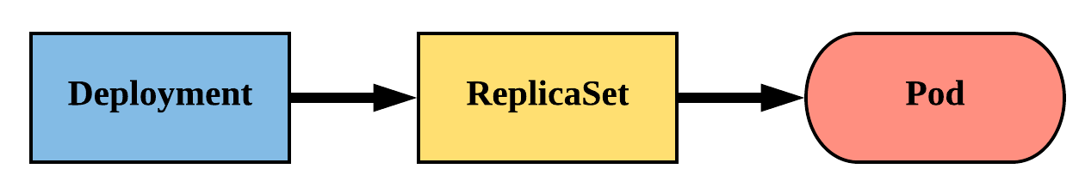
Deployment
Declarative method of managing Pods via ReplicaSets.
Provide rollback functionality and update control.
Notes:
The real way we manage pods
Deployments manage replicasets which then manage pods
Rare that you manage replicasets directly because they are ‘dumb’
Offer update control and rollback functionality, gives blue/green deployment
Does this through hashing the pod template and storing that value in a label, the pod template hash
Used in replicaset name
Added to the selector and pod labels automatically
gives us a unique selector that strictly targets a revision of a pod

Slide 32
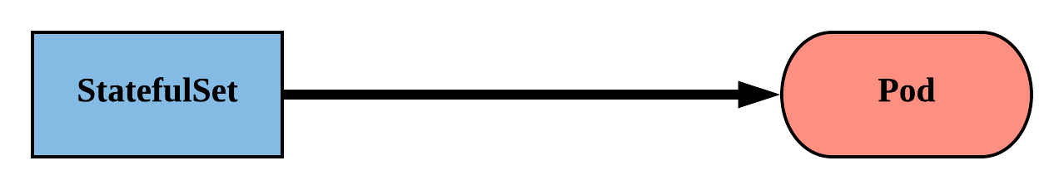
StatefulSet
Tailored to managing Pods that must persist or maintain state.
Pod identity including hostname, network, and storage WILL be persisted.
Assigned a unique ordinal name following the convention of ‘<statefulset name>-<ordinal index>’.
Notes:
Tailored to apps that must persist or maintain state: namely databases
Generally these systems care a bit more about their identity, their hostname their IP etc
instead of that random string on the end of a pod name, they’ll get a predictable value
Follows the convention of statefulset name - ordinal index
ordinal index correlates to replica
Ordinal starts at 0, just like a normal array e.g. mysql-0
naming convention carries over to network identity and storage

Slide 33
Headless Service
<StatefulSet Name>-<ordinal>.<service name>.<namespace>.svc.cluster.local
apiVersion: v1
kind: Service
metadata:
name: app
spec:
clusterIP: None
selector:
app: stateful
ports:
- protocol: TCP
port: 80
targetPort: 80
/ # dig app.default.svc.cluster.local +noall +answer
; <<>> DiG 9.11.2-P1 <<>> app.default.svc.cluster.local +noall +answer
;; global options: +cmd
app.default.svc.cluster.local. 2 IN A 10.255.0.5
app.default.svc.cluster.local. 2 IN A 10.255.0.2
/ # dig sts-example-0.app.default.svc.cluster.local +noall +answer
; <<>> DiG 9.11.2-P1 <<>> sts-example-0.app.default.svc.cluster.local +noall +answer
;; global options: +cmd
sts-example-0.app.default.svc.cluster.local. 20 IN A 10.255.0.2
/ # dig sts-example-1.app.default.svc.cluster.local +noall +answer
; <<>> DiG 9.11.2-P1 <<>> sts-example-1.app.default.svc.cluster.local +noall +answer
;; global options: +cmd
sts-example-1.app.default.svc.cluster.local. 30 IN A 10.255.0.5
$ kubectl get pods
NAME READY STATUS RESTARTS AGE
sts-example-0 1/1 Running 0 11m
sts-example-1 1/1 Running 0 11m
Notes:
Follows pattern of <StatefulSet Name>-<ordinal>.<service name>.<namespace>.svc.cluster.local
Note: clusterIP is set to None

Slide 34
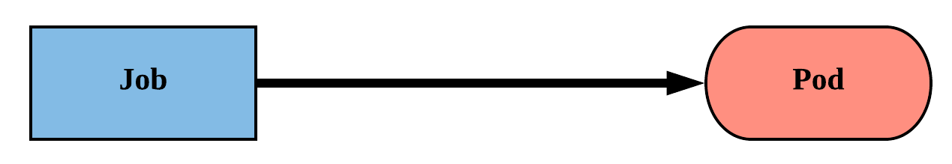
Job
Job controller ensures one or more pods are executed and successfully terminate.
Will continue to try and execute the job until it satisfies the completion and/or parallelism condition.
Pods are NOT cleaned up until the job itself is deleted.*
Notes:
A job workload is run through a job controller. The job controller, put simply, makes sure that things complete successfully.
The controller is dumb, and attempts to achieve its defined requirements via parallelism and completion fields.
Another key thing is that pods aren’t removed once a job completes. They do get cleaned up after a certain defined threshold.

Slide 35
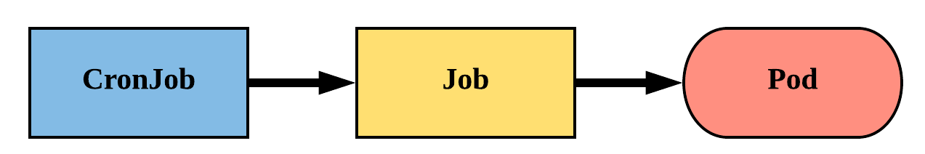
CronJob
An extension of the Job Controller, it provides a method of executing jobs on a cron-like schedule.
CronJobs within Kubernetes use UTC ONLY.

Slide 36
Storage
Pods by themselves are useful, but many workloads require exchanging data between containers, or persisting some form of data.
For this we have Volumes, PersistentVolumes, PersistentVolumeClaims, and StorageClasses.
Notes:
Storage is one of those things that does tend to confuse people with all the various levels of abstractions
4 ‘types’ of storage
Volumes
Persistent Volumes
Persistent Volume Claims
Storage Classes

Slide 37
Volumes
Storage that is tied to the Pod’s Lifecycle.
A pod can have one or more types of volumes attached to it.
Can be consumed by any of the containers within the pod.
Survive Pod restarts; however their durability beyond that is dependent on the Volume Type.
Notes:
A Volume is defined in the pod Spec and tied to its lifecycle
This means it survives a Pod restart, but what happens to it when the pod is deleted is up to the volume type
volumes themselves can be actually be attached to more than one container within the Pod
very common to share storage between containers within the pod
web server
pre-process data
socket files
logs

Slide 38
Volume Types
awsElasticBlockStore
azureDisk
azureFile
cephfs
configMap
csi
downwardAPI
emptyDir
fc (fibre channel)
flocker
gcePersistentDisk
gitRepo
glusterfs
hostPath
iscsi
local
nfs
persistentVolumeClaim
projected
portworxVolume
quobyte
rbd
scaleIO
secret
storageos
vsphereVolume
Persistent Volume Supported
Notes:
Current list of in-tree volume types supported, with more being added through the “Container Storage Interface”
essentially storage plugin system supported by multiple container orchestration engines (k8s and mesos)
The ones in blue support persisting beyond a pod’s lifecycle, but generally are not mounted directly except through a persistent volume claim
emptyDir is common for scratch space between pods
configMap, secret, downward API, and projected are all used for injecting information stored within Kubernetes directly into the Pod

Slide 39
Volumes
volumes: A list of volume objects to be attached to the Pod. Every object within the list must have it’s own unique name.
volumeMounts: A container specific list referencing the Pod volumes by name, along with their desired mountPath.
apiVersion: v1
kind: Pod
metadata:
name: volume-example
spec:
containers:
- name: nginx
image: nginx:stable-alpine
volumeMounts:
- name: html
mountPath: /usr/share/nginx/html
ReadOnly: true
- name: content
image: alpine:latest
command: ["/bin/sh", "-c"]
args:
- while true; do
date >> /html/index.html;
sleep 5;
done
volumeMounts:
- name: html
mountPath: /html
volumes:
- name: html
emptyDir: {}
Notes:
2 Major components with volumes in a Pod Spec:
volumes is on the same ‘level’ as containers within the Pod Spec
volumeMounts are part of each container’s definition

Slide 40
Persistent Volumes
A PersistentVolume (PV) represents a storage resource.
PVs are a cluster wide resource linked to a backing storage provider: NFS, GCEPersistentDisk, RBD etc.
Generally provisioned by an administrator.
Their lifecycle is handled independently from a pod
CANNOT be attached to a Pod directly. Relies on a PersistentVolumeClaim
Notes:
PVs are k8s objects that represent underlying storage.
They don’t belong to any namespace, they are a global resource.
As such users aren’t usually the ones creating PVs, that’s left up to admins.
The way a user consumes a PV is by creating a PVC.

Slide 41
PersistentVolumeClaims
A PersistentVolumeClaim (PVC) is a namespaced request for storage.
Satisfies a set of requirements instead of mapping to a storage resource directly.
Ensures that an application’s ‘claim’ for storage is portable across numerous backends or providers.
Notes:
Unlike a PV, a PVC is based within a namespace (with the pod)
It is a one-to-one mapping of a user claim to a global storage offer.
A user can define specific requirements for their PVC so it gets matched with a specific PV.

Slide 42
Configuration
Kubernetes has an integrated pattern for decoupling configuration from application or container.
This pattern makes use of two Kubernetes components: ConfigMaps and Secrets.
Notes:
There are instances in your application where you want to be able to store runtime-specific information.
Things like connection info, SSL certs, certain flags that you will inevitably change over time.
The Kubernetes takes that into account and has a solution with ConfigMaps and Secrets.
ConfigMaps and Secrets are kind of like Volumes, as you’ll see.

Slide 43
ConfigMap
Externalized data stored within kubernetes.
Can be referenced through several different means:
environment variable
a command line argument (via env var)
injected as a file into a volume mount
Can be created from a manifest, literals, directories, or files directly.
Notes:
Configmap data is stored “outside” of the cluster (in etcd)
They are insanely versatile. You can inject them as environment variables at runtime, as a command arg, or as a file or folder via a volume mount.
They can also be created in a multitude of ways.

Slide 44
Secret
Functionally identical to a ConfigMap.
Stored as base64 encoded content.
Encrypted at rest within etcd (if configured!).
Ideal for username/passwords, certificates or other sensitive information that should not be stored in a container.
Can be created from a manifest, literals, directories, or from files directly.
Notes:
Secrets for the most part are functionally identical to ConfigMaps with a few small key differences
stored as base64 encoded content
encrypted if configured
great for user/pass or certs
and can be created the same way as configmaps

Slide 45
Secret Example
All produce a Secret with the same content!
apiVersion: v1
kind: Secret
metadata:
name: manifest-example
type: Opaque
data:
username: ZXhhbXBsZQ==
password: bXlwYXNzd29yZA==
$ kubectl create secret generic literal-secret \ > --from-literal=username=example \ > --from-literal=password=mypassword
secret "literal-secret" created
$ cat info/username
example
$ cat info/password
mypassword
$ kubectl create secret generic dir-secret --from-file=secret/
Secret "file-secret" created
$ cat secret/username
example
$ cat secret/password
mypassword
$ kubectl create secret generic file-secret --from-file=secret/username --from-file=secret/password
Secret "file-secret" created
Notes:
Same as ConfigMaps except you now have to tell it what kind of secret (we use generic here)

Slide 46
Where to go From Here

Slide 47
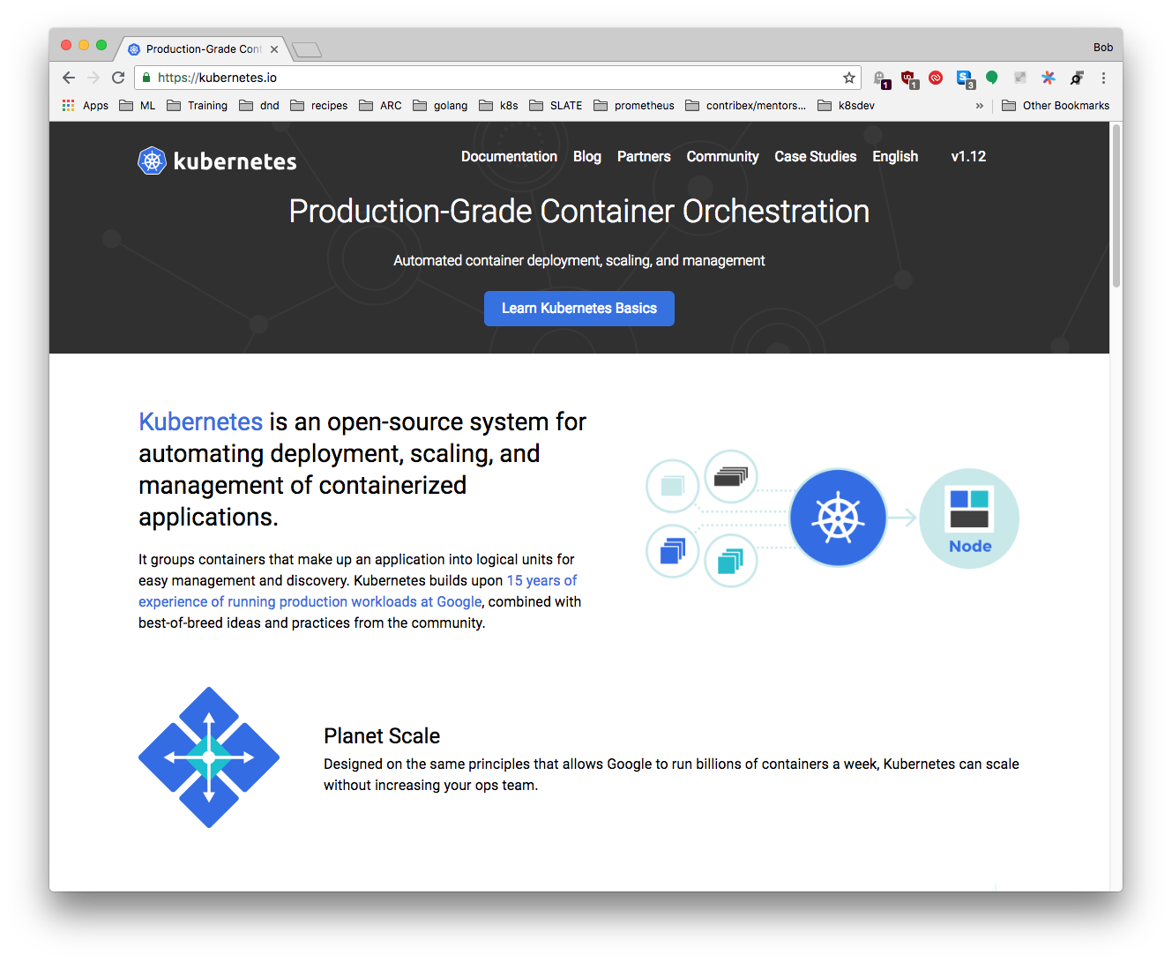
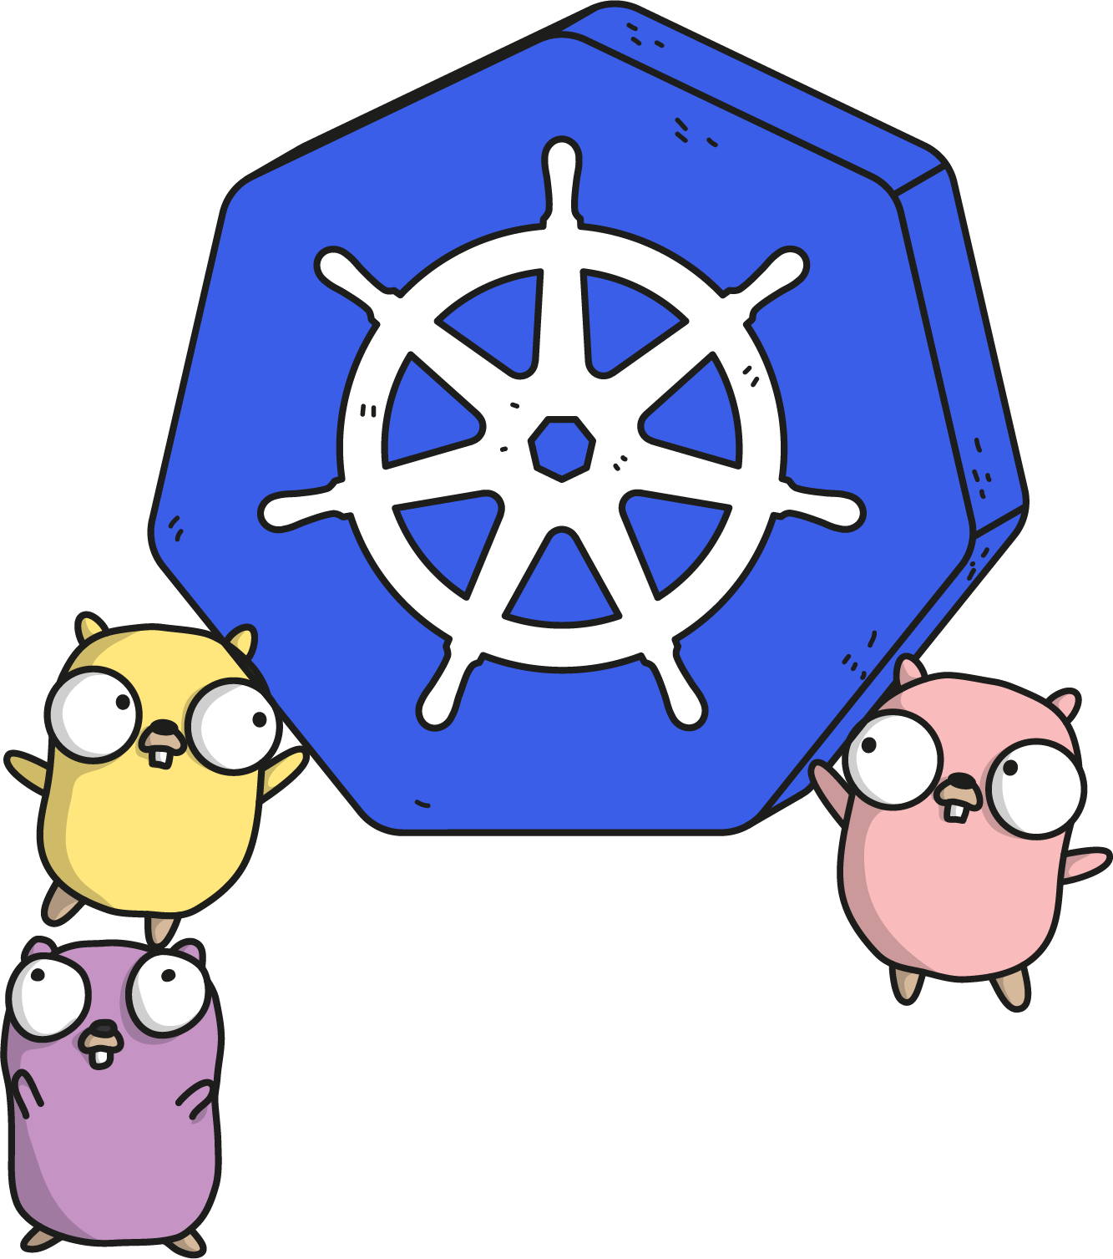
kubernetes.io
Documentation
Examples
API Reference
Notes:
Community driven, constantly updated. The documentation and API references are updated with each release.
There’s an entire group dedicated to this effort.

Slide 48

Slack
Kubernetes
slack.k8s.io
70,000+ users
300+ public channels
CNCF
slack.cncf.io
8,200+ users
70+ public channels
07/2019
Notes:
Two main slacks to be aware of.
The Kubernetes slack has a lot of activity and can be a good place to ask questions or connect with other users.
The CNCF slack isn’t for support, but more for policy and connecting with other places looking to use cloud native technology.
There is also an #academia channel within the CNCF slack that we frequent.

Slide 49


Other Communities
Official Forum https://discuss.kubernetes.io
Subreddit https://reddit.com/r/kubernetes
StackOverflow https://stackoverflow.com/questions/tagged/kubernetes
Notes:
Discuss has taken the place of our old mail group. It is active and many community members watch and answer questions.
There is a Kubernetes subreddit, albeit unofficial, that has some activity.
Finally Kubernetes-tagged Stack Overflow questions are monitored and that activity is even tracked and charted for community engagement.

Slide 50
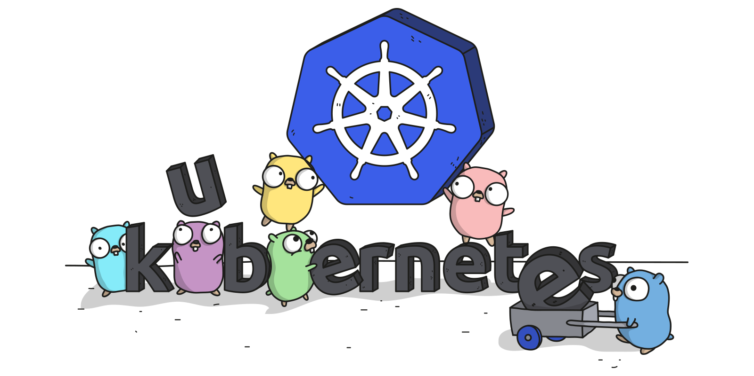
Links
Free Kubernetes Courses https://www.edx.org/
Interactive Kubernetes Tutorials https://www.katacoda.com/courses/kubernetes
Learn Kubernetes the Hard Way https://github.com/kelseyhightower/kubernetes-the-hard-way
Official Kubernetes Youtube Channel https://www.youtube.com/c/KubernetesCommunity
Official CNCF Youtube Channel https://www.youtube.com/c/cloudnativefdn
Track to becoming a CKA/CKAD (Certified Kubernetes Administrator/Application Developer) https://www.cncf.io/certification/expert/
Awesome Kubernetes https://ramitsurana.gitbooks.io/awesome-kubernetes/content/

Slide 51
Questions?

